Slide 1
HESC Update
SUNYFAP 2022

Slide 2
HESC Updates
2022-23 NYS Enacted Budget Highlights
2022-23 Processing
2021-22 Processing
2020-21 Processing
Excelsior Scholarship
Other Processing Reminders
Upcoming Training Opportunities

Slide 3
2022-23 NYS Enacted Budget Highlights

Slide 4
Full Support for HESC programs
Continuing support for over $1 billion in HESC administered financial aid programs
TAP
Excelsior
All other HESC programs

Slide 5
Part-time TAP
Expands Part-time TAP program to cover all otherwise TAP-eligible students
Must meet all eligibility requirements for TAP
Enrolled in 6-11 credits
Eliminates past eligibility requirement to have earned 12 credits or more in each of the two consecutive semesters, for a minimum total of 24 credits earned

Slide 6
Part-time TAP
Expands eligibility to part-time students in non-degree training programs
Students attending community colleges in programs that directly lead to employment or advancement in a significant industry
Identified in NYS Department of Labor’s Statewide Significant Industries Report

Slide 7
TAP for Incarcerated Individuals
Provides incarcerated individuals an opportunity to gain an education by restoring TAP funding
Certify TAP in same manner as other eligible students
Schools must track and report to HESC number of incarcerated TAP recipients each term for 2022-23 academic year

Slide 8
Excelsior Scholarship
Tuition rate charged for Excelsior recipients for 2022-23 is now set at current rate
All students will be charged current rate

Slide 9
Other NYS Scholarships
McGee Nursing Faculty Scholarship
$2 million in additional funding
Young Farmers Loan Forgiveness Program
$500,000 in additional funding
Spending and award caps permanently lifted for these programs

Slide 10
2022-23 Processing

Slide 11
2022-23 Student Status Listing (SSL)
Only fully-approved students listed on SSL
Students meeting initial requirements but pending verification per below will no longer be listed:
Income
Residency
Missing documentation
Awards appearing on SSL will be placed on roster for processing
Excelsior recipients will not appear on the SSL until fully verified and eligible to be placed on manifest
Notes:
Source: www.uscis.gov

Slide 12
2022-23 Student Status Listing (SSL)
Awards not contingent on income appear on SSL once application/renewal process is complete for these programs:
NYS Scholarship for Academic Excellence
World Trade Center Memorial Scholarship
Students can have an award on SSL but TAP still pending IVP
Notes:
Source: www.uscis.gov

Slide 13
2022-23 Student Status Listing (SSL)
To review pending applications, use:
Application Status Report QGA010
Listed under customized reports
Report identifies any errors, missing applications, and denials

Slide 14
2022-23 Income Verification
HESC no longer accepts copies of NYS or Federal tax returns
Students whose income cannot be verified receive instructions on how to review and resolve mismatches with NYS Tax & Finance
Notes:
HESC will no longer accept copies of NYS or Federal Tax returns. Students whose income is unable to be verified with NYS Tax and Finance will be notified and instructed to review their 2022-23 NYS Payment Application and update the income information to mirror the information on their 2020 NYS Tax returns.

Slide 15
2021-22 Processing

Slide 16
2021-22 Excelsior Processing
Prior grant recipients MUST complete NYS Payment Application as part of renewal process
Students have received multiple emails to complete the NYS Payment Application
Deadline to file: June 30th
Students who have not completed the NYS Payment Application by the deadline will not receive award payments

Slide 17
Resolving Excelsior Income Verification
All applicants are submitted to NYS Tax & Finance to verify income (IVP)
Students with mismatches were sent an Excelsior Income Questionnaire
Must be completed and uploaded for further processing
Multiple requests sent to students

Slide 18
Resolving TAP Income Verification
HESC notifies applicants to review correct errors on their 2021-22 NYS Payment Application
Common errors include:
Incorrect parent SSN or Tax ID
Reported last name of parent does not match name used to file tax returns
Incorrect tax return type or filing status for student or parent
Notes:
To resolve income verification issues applicants must review their 2021-22 payment application for errors that may be causing income verification to fail
Common application errors include:
Incorrect parent SSNs or Tax IDs
Reported last name of parent does not match taxes
Incorrect tax return type or filing status for the student or parent

Slide 19
QGE012 – Pending Income Verification Report

Slide 20
2020-21 Processing

Slide 21
2020-21 Academic Year Closeout
All certifications must be processed now
Certify all students on manifest/roster
Make sure to check error report for all programs
Update and resubmit errors
Errors must be corrected and processed before close out of the year or students will not get paid.

Slide 22
Certification Errors on HESCWeb for TAP and Excelsior

Slide 23
HESC Excelsior Error Report

Slide 24
TAP 2020-21 Academic Year Closeout
TAP processing for 2020-21 is closing
Submit all student certifications before May 15, 2022
Any transactions in pending status after May 15th will be decertified by HESC

Slide 25
Excelsior Updates

Slide 26
2021 Excelsior Processing
Schools should send in all credit verification requests at this time
Repeat recipients with no payment application or verified IVP will remain pending
To appear on a manifest
Payment application needs to be submitted
IVP information needs to be verified

Slide 27
2022 Excelsior IVP Processing
New process for students who are not IVP verified with NYS Tax & Finance
Students log into HESC account to verify information and make changes online
New information goes for IVP match
Students not verified must get tax transcript to provide to clear account

Slide 28
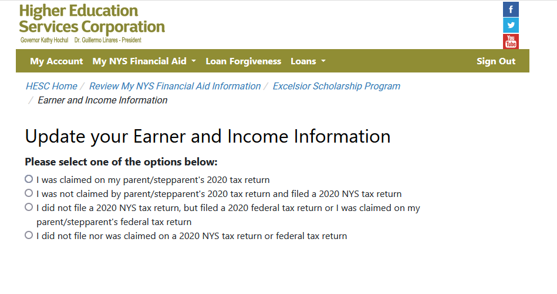
Earner and Income Information Form

Slide 29
New for 2022: Excelsior Appeals
For repeat recipients, approval of appeals for break in attendance or reduced credits now determined by schools
HESC will continue to determine for first time applicants

Slide 30
New for 2022: Excelsior Appeals
Schools will indicate break as part of certification
New certification fields online and batch processing
Information listed on SSL, manifest, and reports
New screen with historical data
More details to follow shortly

Slide 31
Other Processing Reminders

Slide 32
Excelsior Processing Reminders
Credit Verifications
Continuing Excelsior recipients who transfer in good standing do not get a new credit verification request sent to the transfer school
Transfer school must evaluate eligibility during Excelsior certification process
Student is eligible at time of transfer for evaluation term one

Slide 33
Upcoming Training Opportunities

Slide 34
HESC Spring Training opportunities
TAP eligibility and certification
2022 Excelsior training and updates
New user training
New initiatives
Program updates
Consolidated Roster processing
APTS program
Payments

Slide 35
Questions

Slide 36
Thank you

