Slide 1
Foster Youth College Success Initiative (FYCSI) FAP Director’s Meeting
Osei Agyeman
Fiscal Manager, FYCSI Coordinator, & Campus liaison for Suny Office of Opportunity Programs

Slide 2
The Factors/Challenges Of YouTH IN Care Completing College in 21-22
Obstacles during a pandemic
Health (Mental/Physical) (All Time Highs)
Social Isolation
Housing insecurity
Financial Insecurity
Food Insecurity
Lack of parental/guardian social and economic support

Slide 3
Fostering Youth SUCCESS (FYSA) “Moving Forward” data From 2020
https://readymag.com/fysa/movingforward/

Slide 4
What is the Foster youth College Success initiative?
The Foster Youth College Success Initiative (FYCSI) is a program established in 2015 specifically for students who have experienced foster care, eligible orphans, or are wards of the court.
Awarded throughout the 3 sectors Public (SUNY), Private, CUNY.
FYCSI operates as part of New York State’s opportunity programs but since 2019, a student no longer has to be EOP to receive funds
FYCSI was established to help youth in care or alumni successfully enroll in to and graduate from college by providing essential academic support services and financial assistance that makes it possible for them to attend college and successfully graduate. The focus is to eliminate debt.

Slide 5
What Does it assist with?
This funding can be used towards supporting the cost of attending college, including but not limited to:
Tuition and fees
Books
Meals
Transportation
Housing (Recess Housing)-Letter sent to campuses form HESC about recess housing
On-Campus Tutoring not covered by the campus
Summer Courses
Personal expenses (formulas)
Medical Expenses primary care, behavioral health, vision & dental

Slide 6
Eligibility Requirements
Any student who is currently a resident of New York State and spent time in foster care at any time after their 13th birthday, or is an orphan, is eligible for funding. Documentation confirming eligibility will be required by your school.
MUST be a NYS resident and enrolled in a SUNY college or university; AND
Students MUST meet the federal Higher Education Act definition of a foster youth or orphan (Became an orphan after the 13th Birthday)
Federal definition of a foster youth: student who is currently in foster care, or was in foster care at some point after their 13th birthday. This includes:
Students adopted from foster care after their 13th birthday;
Students living with a relative or kin under a kinship foster care agreement;
Students who have aged out of foster care; and
Students that were in foster care in another state, but meet the opportunity program residency requirements (a NY resident for at least 1 year or received a high school diploma in NY)

Slide 7
Process Reminders
In 2022-23 The required OCFS Consent Form was only used to verify New FYCSI students
Students who have received funding in the past will NOT have to be verified again. Once eligible always eligible.
I usually send an email with a roster template late May/Early June requesting a list of your returners that are expected to return in Fall. You would notify us of non-returners as well.
You would also be cc’d on a letter from SED with similar communication to college presidents in late June. This will be for new and returning students.
Orphans often do not appear in the state system, so OCFS cannot verify them. Orphans are verified by the campus with supporting documentation. They will still have to complete a consent form as well, just for OCFS’ records.
Starting Fall 2022, the “Were You Ever a Foster Care, Ward of the Court, or Orphan?” question will be added to the TAP application. Those who answered yes will be routed to a link to download the consent form to send to OCFS. This was created to capture more eligible students.

Slide 8
Good News!
In the Final NY State Budget there was a increase to from $7.2 million this year (21-22) to $8.16 million for (22-23) divided amongst the 3 sectors (SUNY, CUNY, Privates)
The years prior to 21-22 the FYCSI award has been $6 million.
The increase may or may not increase the per student award. I do not expect it to decrease. Further clarification in the next portion.

Slide 9
Student Specifics
If you find students who think they may be eligible though the deadline has passed, encourage the student to submit a consent form to: FCY4College@ocfs.ny.gov It is not guaranteed that funding will be available for the newly eligible students for this year.
There is no separation between EOP and Non-EOP FYCSI youth. The funds are drawn from the same source.
The award per student was up to $9000 for the 21-22 academic year. We do not know what the 22-23 award level will be. We will know have after we have the aggregate number of eligible youth. After that number sent to SED they will determine the amount via their formula. Please keep track of the funds as a report will be required from SED on fund usage. This report goes out every year.
Due to the form of payment it is imperative that community colleges accurately report out the amount of funds remaining on campus to the SUNY Budget Office. Failure to do so could hold up sending additional funds if needed.
If there is a situation where a student may need more than the threshold due to extenuating circumstances (i.e. intersession housing, food insecurity) please contact me.

Slide 10
Intersession Housing

Slide 11
Intersession Continued
A student can use FYCSI funds for housing during breaks (we do not require a student be enrolled during the break)
Funds can also cover meals during this time

Slide 12
SED FYCSI Reports
At the end of every academic year, SED requires a report from the financial aid offices informing how and where the funds were spent. The report template is usually sent out to your campuses. The template includes a data dictionary.
Only FYCSI funds, not the students’ full package summary are asked to be reported. There are several categories (Housing, Tuition, Travel Expenses, etc.)
These reports are vital in securing funds for the future and obviously a safety net for auditing purposes for your campus as well as SUNY as a whole.

Slide 13
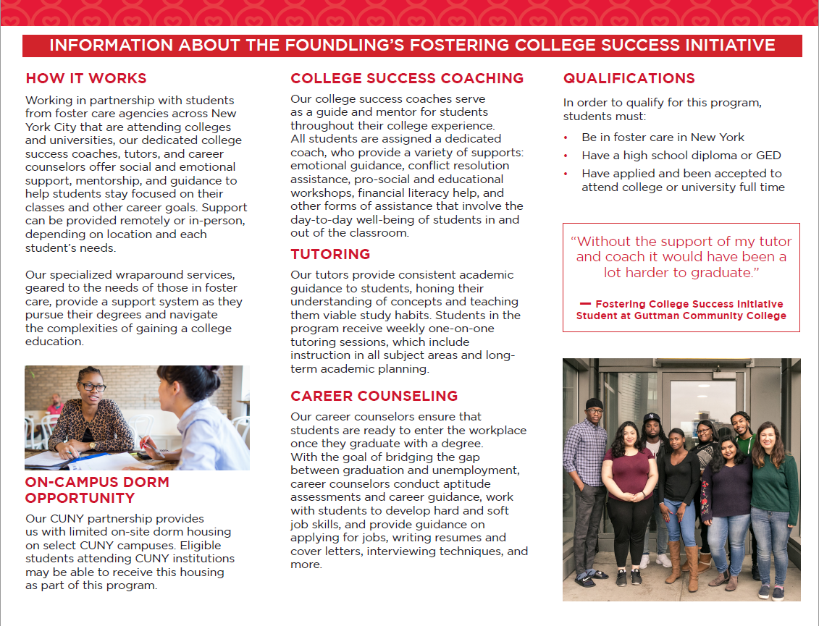
Fostering College SUCCESS Program (FCSI) (Not to be confused with FYCSI)
https://www.fosteringcollegesuccessinitiative.org/

Slide 14
Emergency Response Support for Foster youth
24-48 turnaround
Emergency Response
Off-campus housing emergency assistance
Grocery support

Slide 15
TWC Student Referral Checklist

Slide 16
Fostering Excellence
Purpose: Supplemental Services for Youth in Care
• Facilitate the students’ transition to college, foster a sense of belonging, build community, and prepare the students for academic success. FY Advocates would guide the students to and through their college journeys.
• Provide opportunities for paid Internships.
• Programming and mental health support during the holidays and winter sessions so that students remaining on campus feel supported and less isolated.

Slide 17
Making College A Success Guide
Please visit: https://www.fysany.org/college-success-guide/table-contents

Slide 18
Contact
Osei Agyeman, Fiscal Manager of EOP, SUNY Campus Liaison for the Colleges of Technology, & FYCSI Coordinator
Email: osei.agyeman@suny.edu
Phone: 518-320-1619

Slide 19
Questions?

