Slide 1
Excelsior Scholarship Certification
SUNYFAP
April 2018

Slide 2
Searching for Excelsior Scholarship Recipients

Slide 3
Customized Reports
Excelsior recipients listed on Excelsior Manifest QGE010 in transaction processing on reports tab
Excelsior Manifest can be saved as PDF or spreadsheet
Includes all current Excelsior recipients
Secure Transaction Processing
Excelsior Manifest (QGE010)
Login
G & S
Customized Reports
Reports Tab

Slide 4
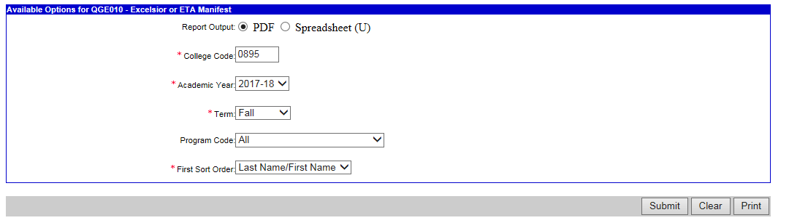
Customized Report

Slide 5
Certification Process

Slide 6
School Certification
College certifies eligibility at end of each term:
  Tuition rate charged to student
  Number of credits completed
  Cumulative credits earned
  Other scholarship amounts
  Number of credits enrolled/earned
  Excelsior Scholarship award amount
  Final term indicator

Slide 7
School Certification
Two new files for processing Excelsior Scholarship awards
  Excelsior Manifest (HE8976)
  Excelsior Certification (HE8977)

Slide 8
School Certification
Excelsior Manifest (HE8976)
  Commonly called the Manifest
  Outgoing from HESC to colleges
  Initially contains all Excelsior recipients

Slide 9
School Certification
Excelsior Certification (HE8977)
  Commonly called the Certification File
  Incoming to HESC from colleges
  Reports initial certification and certification changes from the college

Slide 10
Certification File – HE8977: Familiar Fields
Term Code
Academic Year
Certification Code
  Values 2, 3, & 7 not applicable
ADA Status Code

Slide 11
Certification File – HE8977: New Fields
Financial Aid Program Code - 58
Evaluation Term Indicator
Final Term Indicator
Term Credits Enrolled
Evaluation Year Credits Earned
Total Credits Earned
Five Year Program Code
Excelsior Tuition Credit Amount

Slide 12
Evaluation Term Indicator
Identifies if term being certified is first or second term of evaluation year
Used by HESC to assess progress towards timely degree completion
Based on very first term the student began earning credits - regardless of when student first received Excelsior Scholarship

Slide 13
Final Term Indicator
Identifies the final term needed to graduate
Used to authorize payment where less than 12 credits are needed to graduate
Must be enrolled for at least 12 credits
Does not need to earn 30 credits applicable toward their degree within the evaluation year

Slide 14
Term Credits Enrolled
Number of credits student was enrolled for at the start of term
Credits must be applicable to their degree
Final term exemption

Slide 15
Evaluation Year Credits Earned
Total number of credits earned toward degree during evaluation year
Used by HESC to determine if a student will graduate on time

Slide 16
Total Credits Earned
Used by HESC to determine if a student will graduate on time
Applicable toward program of study
May include transfer credits
May include AP credits

Slide 17
AP Credits
May be reported as credits earned in any Evaluation Term
May be used only once

Slide 18
Five-Year Program Code
0 - not applicable; enrolled in a four year degree program
2 - enrolled in a two-year program (AS)
5 - enrolled in a five-year program or approved opportunity program

Slide 19
Excelsior Tuition Credit Amount
Value of tuition not covered by Excelsior, other aid, and TAP Tuition Credit
Reported by the college
Final determination is done by HESC

Slide 20
Summer and Winter Terms
Semester-based schools are not eligible for Excelsior award payments for these terms
May be used to supplement credits earned in evaluation terms 1 or 2

Slide 21
School Certification
After second term, schools will certify if:
  Enrolled in 12 credits each term
  Completed 30 credits over 365 days

Slide 22
Online Certification in HESCWeb Transaction Processing

Slide 23
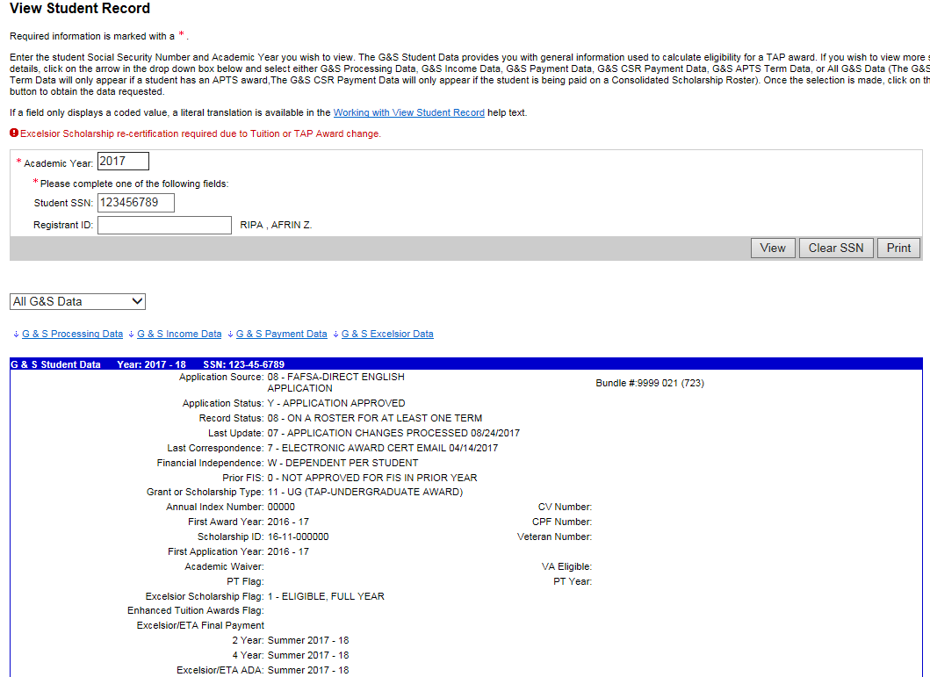
View Student Record

Slide 24
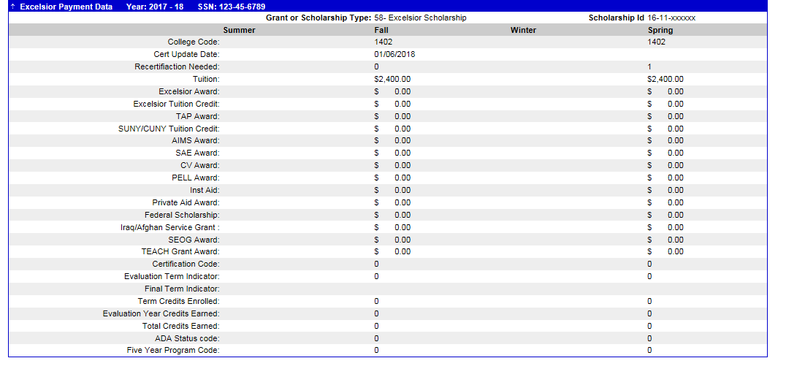
View Student Record – Excelsior Payment Data

Slide 25
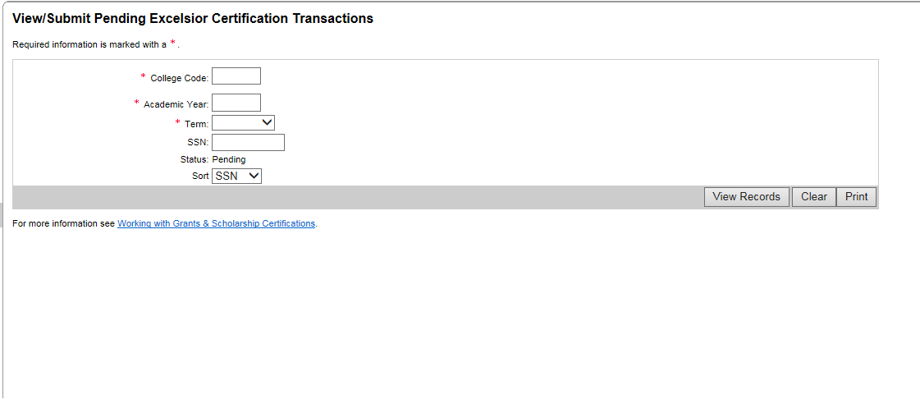
View Pending Excelsior Student Certification Transaction screens

Slide 26
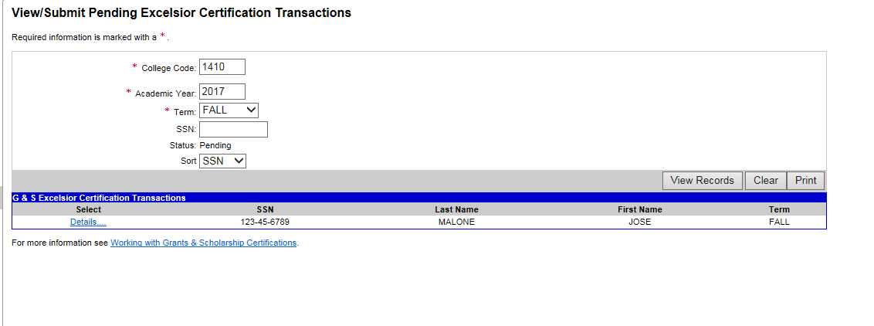
View/Submit Pending Excelsior Student Certification Transactions

Slide 27
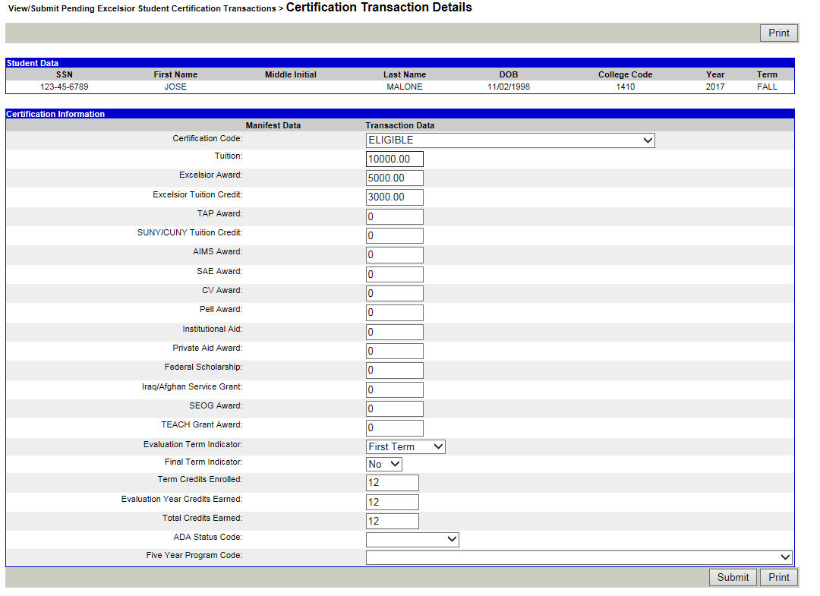
View/Submit Pending Excelsior Student Certification Transactions>Certification Transactions details

Slide 28
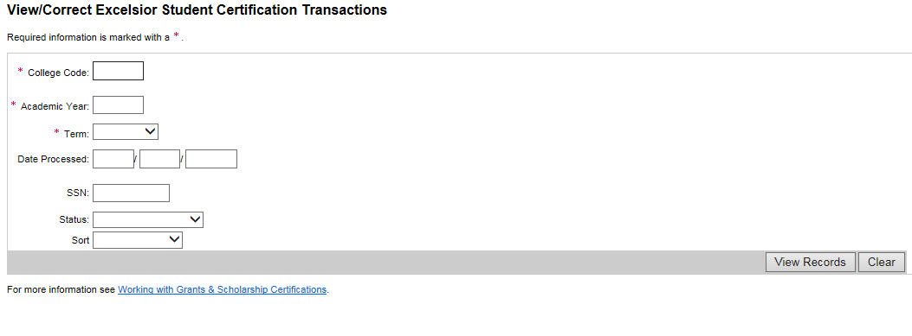
View/Correct Excelsior Student Certification Transactions

Slide 29
Certification Details page

Slide 30
School Payment
Payments made to colleges at end of term
Non-prepay
First term award payments for students who enroll in 12 credits for first term but fail to meet 30-credit requirement

Slide 31
School Payment
Payments made on a daily basis
New college accounting for Excelsior Scholarship

Slide 32
Questions?
Contact Information:
Barbara Hochberg
Director Grants and Scholarship Programs
Barbara.Hochberg@hesc.ny.gov

